Slide 1
AR (Auto-Regressive) Model
The time period at t is impacted by the observation at various slots t-1, t-2, t-3, ….., t-k.
The impact of previous time spots is decided by the coefficient factor at that particular period of time.
The price of a share of any particular company X may depend on all the previous share prices in the time series.
This kind of model calculates the regression of past time series and calculates the present or future values in the series in know as Auto Regression (AR) model.
Yt = β₁* y-₁ + β₂* yₜ-₂ + β₃ * yₜ-₃ + ………… + βₖ * yₜ-ₖ
Consider an example of a milk distribution company that produces milk every month in the country. We want to calculate the amount of milk to be produced current month considering the milk generated in the last year.
We begin by calculating the PACF values of all the 12 lags with respect to the current month. If the value of the PACF of any particular month is more than a significant value only those values will be considered for the model analysis.

Slide 2
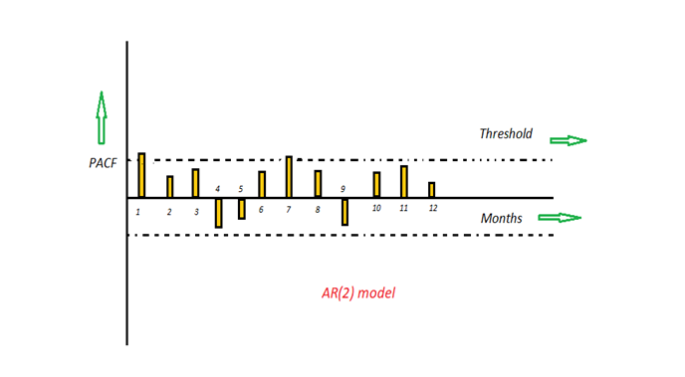
For e.g in the above figure the values 1,2, 3 up to 12 displays the direct effect(PACF) of the milk production in the current month w.r.t the given the lag t. If we consider two significant values above the threshold then the model will be termed as AR(2).
PACF is the partial autocorrelation function that explains the partial correlation between the series and lags of itself. In simple terms, PACF can be explained using a linear regression where we predict y(t) from y(t-1), y(t-2), and y(t-3) .

Slide 3
MA (Moving Average) Model
The time period at t is impacted by the unexpected external factors at various slots t-1, t-2, t-3, ….., t-k.
These unexpected impacts are known as Errors or Residuals. The impact of previous time spots is decided by the coefficient factor α at that particular period of time.
The price of a share of any particular company X may depend on some company merger that happened overnight or maybe the company resulted in shutdown due to bankruptcy.
This kind of model calculates the residuals or errors of past time series and calculates the present or future values in the series in know as Moving Average (MA) model.
Yt = α₁* Ɛₜ-₁ + α₂ * Ɛₜ-₂ + α₃ * Ɛₜ-₃ + ………… + αₖ * Ɛₜ-ₖ
Consider an example of Cake distribution during my birthday. Let's assume that your mom asks you to bring pastries to the party. Every year you miss judging the no of invites to the party and end upbringing more or less no of cakes as per requirement. The difference in the actual and expected results in the error. So you want to avoid the error for this year hence we apply the moving average model on the time series and calculate the no of pastries needed this year based on past collective errors.

Slide 4
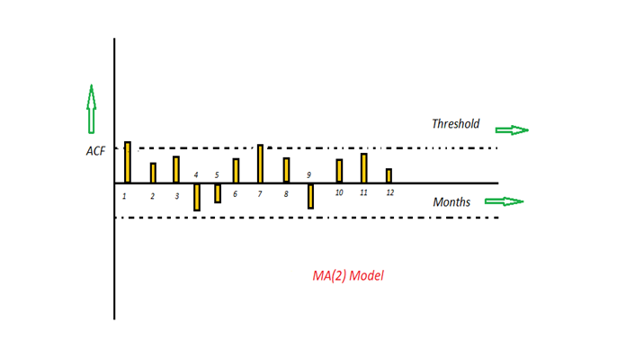
For e.g in the above figure the values 1,2, 3 up to 12 displays the total error(ACF) of count in pastries current month w.r.t the given the lag t by considering all the in-between lags between time t and current month. If we consider two significant values above the threshold then the model will be termed as MA(2).
ACF plot is a bar chart of coefficients of correlation between a time series and it lagged values. Simply stated: ACF explains how the present value of a given time series is correlated with the past values.
y(t), y(t-1),….y(t-n) are values of a time series at time t, t-1,…,t-n, then the lag-1 value is the correlation coefficient between y(t) and y(t-1), lag-2 is the correlation coefficient between y(t) and y(t-2) and so on.

Slide 5
ACF (Auto Correlation Function)
Auto Correlation function takes into consideration of all the past observations irrespective of its effect on the future or present time period. It calculates the correlation between the t and (t-k) time period. It includes all the lags or intervals between t and (t-k) time periods. Correlation is always calculated using the Pearson Correlation formula.
PACF(Partial Correlation Function)
The PACF determines the partial correlation between time period t and t-k. It doesn’t take into consideration all the time lags between t and t-k. For e.g. let's assume that today's stock price may be dependent on 3 days prior stock price but it might not take into consideration yesterday's stock price closure. Hence we consider only the time lags having a direct impact on future time period by neglecting the insignificant time lags in between the two-time slots t and t-k.
For the AR process, we expect that the ACF plot will gradually decrease and simultaneously the PACF should have a sharp drop after p significant lags.
To define a MA process, we expect the opposite from the ACF and PACF plots, meaning that: the ACF should show a sharp drop after a certain q number of lags while PACF should show a geometric or gradual decreasing trend.
On the other hand, if both ACF and PACF plots demonstrate a gradual decreasing pattern, then the ARMA process should be considered for modeling.

Slide 6
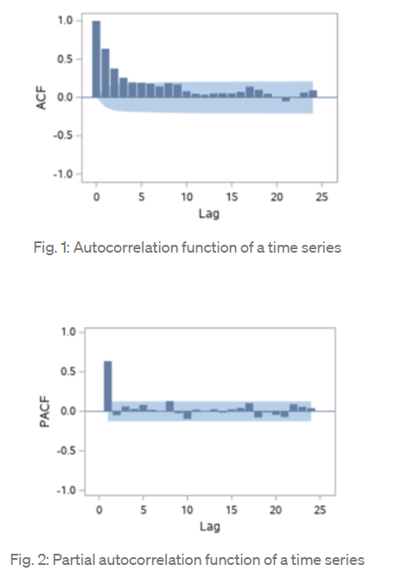
Fig. 1 and 2 illustrate ACF and PACF for a given stationary time series data. The ACF shows a gradually decreasing trend while the PACF cuts immediately after one lag. Thus, the graphs suggest that an AR (1) model would be appropriate for the time series.

Slide 7
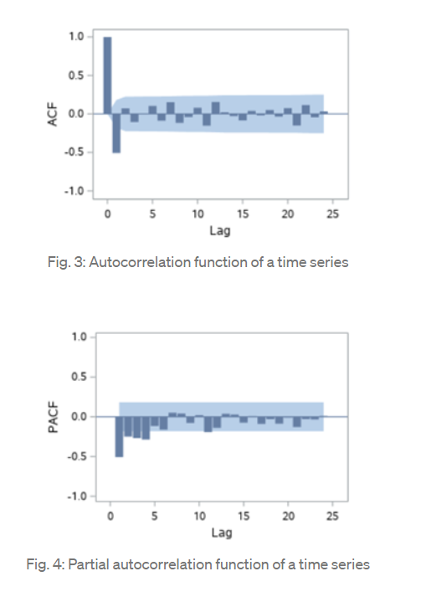
Fig. 3 and 4 show ACF and PACF for a stationary time series, respectively. The ACF and PACF plots indicate that an MA (1) model would be appropriate for the time series because the ACF cuts after 1 lag while the PACF shows a slowly decreasing trend.

Slide 8
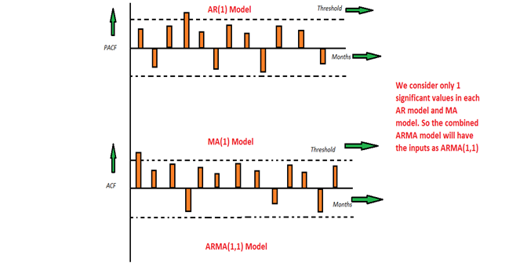
ARMA (Auto Regressive Moving Average) Model
This is a model that is combined from the AR and MA models. In this model, the impact of previous lags along with the residuals is considered for forecasting the future values of the time series. Here β represents the coefficients of the AR model and α represents the coefficients of the MA model.
Yt = β₁* yₜ-₁ + α₁* Ɛₜ-₁ + β₂* yₜ-₂ + α₂ * Ɛₜ-₂ + β₃ * yₜ-₃ + α₃ * Ɛₜ-₃ +………… + βₖ * yₜ-ₖ + αₖ * Ɛₜ-ₖ
Consider the graphs where the MA and AR values are plotted with their respective significant values. Let's assume that we consider only 1 significant value from the AR model and likewise 1 significant value from the MA model. So the ARMA model will be obtained from the combined values of the other two models will be of the order of ARMA(1,1).

Slide 9
The ARIMA Time Series Model
One of the most common methods used in time series forecasting is known as the ARIMA model, which stands for AutoregRessive Integrated Moving Average.
ARIMA is a model that can be fitted to time series data in order to better understand or predict future points in the series.
here are three distinct integers (p, d, q) that are used to parametrize ARIMA models. Because of that, ARIMA models are denoted with the notation ARIMA(p, d, q). Together these three parameters account for seasonality, trend, and noise in datasets:
p is the auto-regressive part of the model. It allows us to incorporate the effect of past values into our model. Intuitively, this would be similar to stating that it is likely to be warm tomorrow if it has been warm the past 3 days.
d is the integrated part of the model. This includes terms in the model that incorporate the amount of differencing (i.e. the number of past time points to subtract from the current value) to apply to the time series. Intuitively, this would be similar to stating that it is likely to be same temperature tomorrow if the difference in temperature in the last three days has been very small.
q is the moving average part of the model. This allows us to set the error of our model as a linear combination of the error values observed at previous time points in the past.

Slide 10
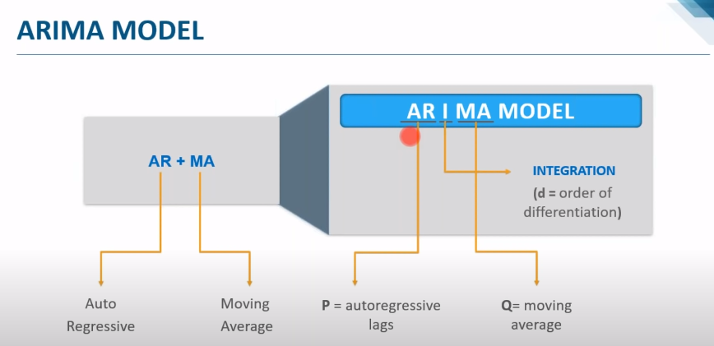
So in short ARIMA model is a combination of a number of differences already applied on the model in order to make it stationary, the number of previous lags along with residuals errors in order to forecast future values.
When dealing with seasonal effects, we make use of the seasonal ARIMA, which is denoted as ARIMA(p,d,q)(P,D,Q)s.
Here, (p, d, q) are the non-seasonal parameters described above, while (P, D, Q) follow the same definition but are applied to the seasonal component of the time series.
The term s is the periodicity of the time series (4 for quarterly periods, 12 for yearly periods, etc.).

